Slide 1
Dynamic Spatially Isolated Secure Zones for NoC-based Many-core Accelerators
Maria Méndez Real, Vincent Migliore, Vianney Lapotre, Guy Gogniat
Lab-STICC Université de Bretagne-Sud Lorient FRANCE
Philipp Wehner, Diana Göhringer
Ruhr-University Bochum, GERMANY

Slide 2
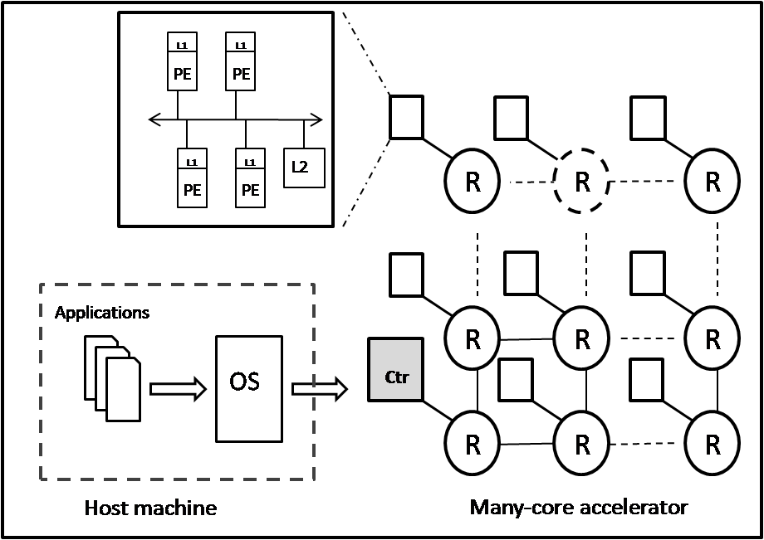
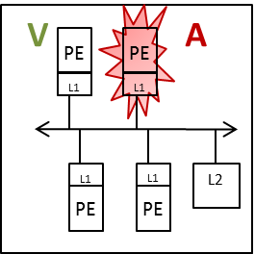
Context: NoC-based many-core accelerator
V: Victim
A: Attacker
A controller is in charge of the deployment of the applications on the accelerator
Trusted and untrusted processes executing in parallel sharing resources
-> cache-based Side-Channel Attacks (SCA)

Slide 3
Context: Cache-based Side-Channel Attacks
Cache-based Side-Channel Attacks due to cache sharing
Principle:
Caches are seen as leakage channels
The attacker behaves as a normal process
Analyzes its own activity
Determine cache lines or sets accessed by the victim
Deduce sensitive information
Various implementations
AES, RSA, ECC
Different architectures (Intel, AMD, ARM) [2]
[2] “Y. Yarom, et al., “FLUSH+RELOAD: A High Resolution, Low Noise, L3 Cache Side-Channel Attack”, in the 23th USENIX Security Simposium, 2014.

Slide 4
Countermeasures against access-driven attacks
Application specific
Software countermeasures:
Changing the implementation of cryptographic algorithms [3]
Hardware countermeasures:
Disabling cacheability
Flushing the cache after each context switch [4]
Changing the cache design -> Partitioned cache [5]
Two separate virtual worlds on the same processor [6]
Too expensive
-> not doable
Solution at the processor level only
[3] J. Blomer and V. Krummel, “Analysis of Countermeasures Against Access Driven Cache Attacks on AES,” Selected Areas in Cryptography,vol. 4876, pp. 96–109, 2007.
[4] Guanciale, et al., “Cache Storage Channels: Alias-Driven Attacks and Verified Countermeasures,” in IEEE Symposium on Security and Privacy, 2016.
[5] Wang and R. B. Lee, “New Cache Designs for Thwarting Software Cache-based Side Channel Attacks,” in IEEE Symposium on Computer Architecture (ISCA), 2007, pp. 494–505.
[6] www.arm.com/products/processors/technologies/trustzone/

Slide 5
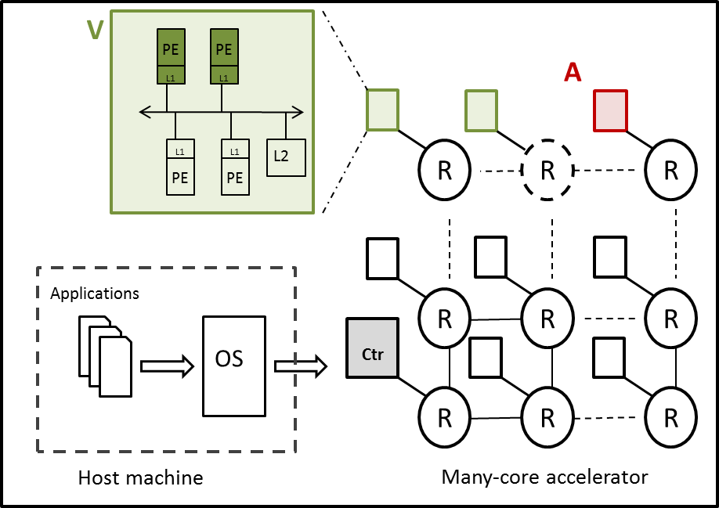
Spatial isolation for sensitive applications
The NoC is secured
How can this be achieved?
Expected under utilization of resources, how can the performance overhead be evaluated?

Slide 6
Implementation
A dedicated processor behaves as a controller of the platform
Evaluation of different deployment strategies for the controller
Scheduling
Monitoring of the platform state
Resource allocation algorithms
Secure zones creation strategies
SW controller is trusted
[7] M.Méndez Real et al., “ALMOS many-core operating system extension with new secure-enable mechanisms for dynamic creation of secure zones,” in Proc. of Euromicro international Conference on Parallel, Distributed and Network-Based Processing (PDP), 2016.

Slide 7
Secure-enable mechanisms
Scheduling: Round Robin
Monitoring: Quaternary decision tree structure
Task mapping: Leverage the data accesses locality
2
C
1
C
C
0
2
M : Memory utilization rate
U : Processor utilization
S : Secure zone dedicated
C
C
0
1
c0
c1
c2
c3
total
C
M
M
M
M
M
0
U
U
U
U
U
C
S
S
S
S
S
c0
c1
c2
c3

Slide 8
Secure-enable mechanisms
Isolated application -> secure zone creation:
Static SZ size
2
C
Idle cluster
1
Active cluster
C
Secure zone cluster
C
0
2
M : Memory utilization rate
U : Processor utilization
S : Secure zone dedicated
C
C
0
1
c0
c1
c2
c3
total
C
M
M
M
M
M
0
U
U
U
U
U
C
S
S
S
S
S
c0
c1
c2
c3

Slide 9
Secure-enable mechanisms
Isolated application -> secure zone creation:
Static SZ size
Dynamic SZ size
2
C
Idle cluster
1
Active cluster
C
Secure zone cluster
C
0
2
M : Memory utilization rate
U : Processor utilization
S : Secure zone dedicated
C
C
0
1
c0
c1
c2
c3
total
C
M
M
M
M
M
0
U
U
U
U
U
C
S
S
S
S
S
c0
c1
c2
c3

Slide 10
Experimental setup
Virtual prototyping: OVP-based MPSoCSim [8]
Experimental protocol:
4x4 clusters architecture (60 MB + 1 ARM)
Matrix multiplications, 17 parallel tasks for each multiplication
5 applications -> 85 tasks running in parallel
Different deployment strategies:
Secure zones of fixed size
Secure zones with dynamic size
Different execution scenarios:
Baseline scenario
One isolated application arriving at first
One isolated application at the middle of the execution
Three isolated applications
Maximum parallelism (5 clusters)
Limited resources (4 clusters)
[8] M.Méndez Real et al., “MPSoCSim extension: An OVP Simulator for the Evaluation of Cluster-based Multicore and Many-core architectures,” in Proc. Workshop on Virtual Prototyping of Parallel and Embedded Systems (ViPES) as part of the International Conference on Embedded Computer Systems: Architectures, Modeling, and Simulation (SAMOS XV), 2016.

Slide 11
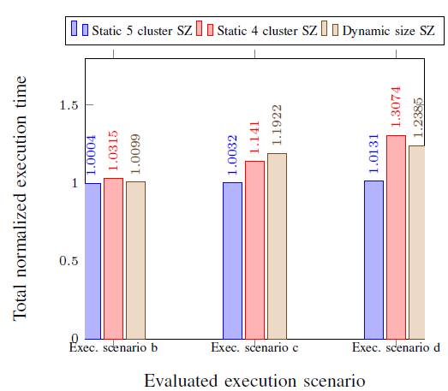
Results
Total execution time normalized to the baseline scenario:
Up to 30% overhead
Negligible overhead when no load
b. One isolated application with the highest priority
c. One isolated application with a medium priority
d. Three isolated applications

Slide 12
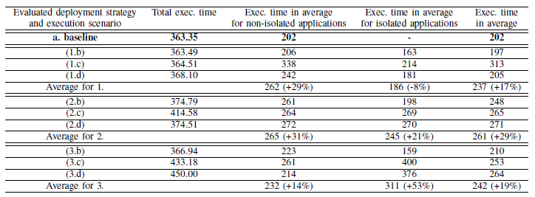
Results
Exec. time of non isolated, isolated application (in msec.) and in average:
The static (5 clusters) strategy leverages the performance of isolated applications
1. Static SZ
size
(5 clusters)
2. Static SZ size
(4 clusters)
3. Dynamic
SZ size
The dynamic strategy leverages the performance of non isolated applications
b. One isolated application with the highest priority
c. One isolated application with a medium priority
d. Three isolated applications

Slide 13
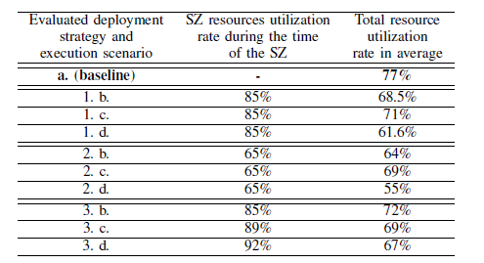
Results
Resources utilization rate:
1. Static SZ size
(5 clusters)
2. Static SZ size
(4 clusters)
3. Dynamic SZ size
The dynamic strategy achieves the highest resource utilization rate

Slide 14
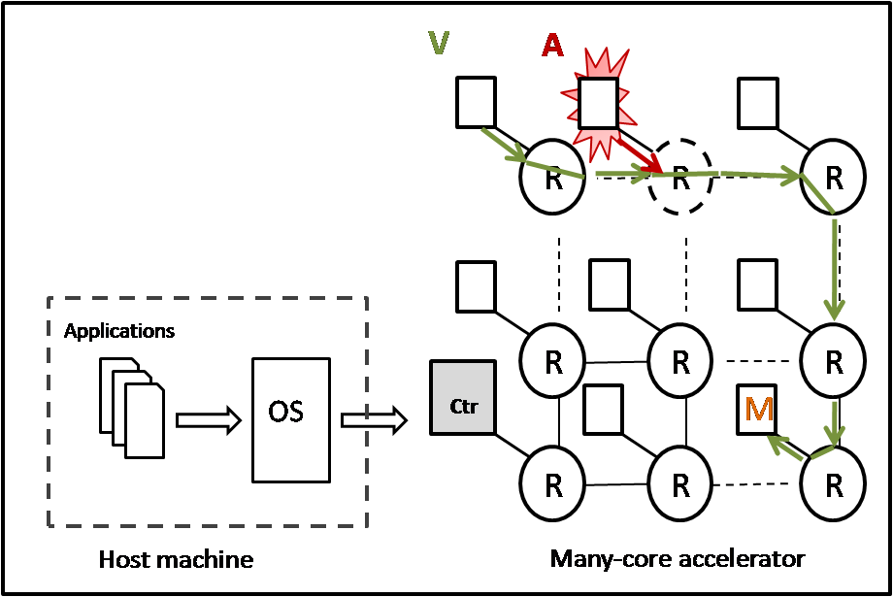
Conclusion and future work
Spatial isolation of sensitive applications VS cache-based SCA
Evaluation on different execution scenarios with different strategies through virtual prototyping
According to the deployment strategy, isolated or/and non isolated applications performance is leveraged
Future work: NoC protection

Slide 15
Thank you for your attention!

