Slide 1
MPSoCSim extension: An OVP Simulator for the Evaluation of Cluster-based Multi and Many-core architectures
Maria Méndez Real, Vincent Migliore, Vianney Lapotre and Guy Gogniat
Université Bretagne-Sud, Lab-STICC, Lorient, France {maria.mendez,name.surname}@univ-ubs.fr
Philipp Wehner, Jens Rettkowski
and Diana Göhringer
Ruhr-University, Bochum, Germany
{philipp.wehner,jens.rettkowski,diana.goehringer}@rub.de

Slide 2
Outline
Motivation
MPSoCSim
MPSoCSim extension
Results
Use case
Conclusion

Slide 3
Motivation
Evaluation of
Multi/Many core architectures
Clustered Network-on-Chip (NoC)-based architectures
Shared resources within clusters
Independent applications running in parallel
Very fast simulation time
MPSoCSim: An Open Virtual Platform (OVP)-based simulator for the evaluation of NoC-based systems
Extension of MPSoCSim in order to support
Clusters composed of several processors
Processors access private and shared resources
Processors execute different applications

Slide 4
MPSoCSim
Overview
MPSoCSim [1] motivation:
Design space of NoC-based systems
An adjustable SystemC NoC
Traffic generators + OVP processor models
Provides performance and communication statistics results
[1] “P. Wehner, et al., “MPSoCSim: An extended OVP Simulator for Modeling and Evaluation of NoC based heterogeneous MPSoCs”, in proc. of ViPES in SAMOS, 2015.

Slide 5
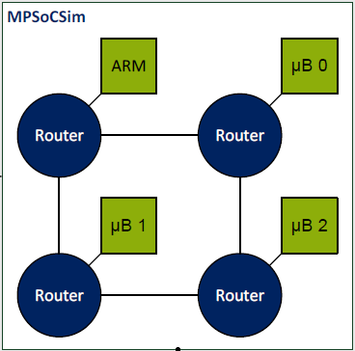
MPSoCSim
NoC
Adjustable SystemC NoC (NoC size, NoC frequency, routing parameters)
2-D mesh supporting wormhole routing
Several routing algorithms: XY, minimal west-first, adaptive west-first
[1] “P. Wehner, et al., “MPSoCSim: An extended OVP Simulator for Modeling and Evaluation of NoC based heterogeneous MPSoCs”, in proc. of ViPES in SAMOS, 2015.

Slide 6
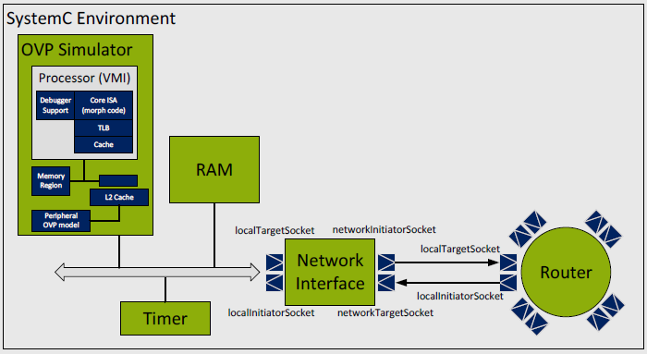
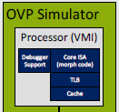
MPSoCSim
Node
SystemC Transaction Level Modeling (TLM) Network Interface (NI)
Memory accessible by local elements to communicate with distant nodes processors => SendData API
Traffic generators + OVP processors models
OVP suitable as it provides several peripheral and processor models (ARM, MIPS, Xilinx, ORK1,…)
An MPSoCSim node [1]
[1] “P. Wehner, et al., “MPSoCSim: An extended OVP Simulator for Modeling and Evaluation of NoC based heterogeneous MPSoCs”, in proc. of ViPES in SAMOS, 2015.

Slide 7
MPSoCSim
MPSoCSim parameters
OVP processor
Frequency, MIPS, Quantum
NoC parameters
NoC size
NoC frequency
routing algorithm
delay routing
delay pass-through

Slide 8
MPSoCSim
Exploitation results
OVP processor
NoC parameters
NI statistics
Number of messages received
Mean number of hops
Mean delay
Bytes received
Bytes transmitted
Max data rate received
Max data rate transmitted
…
Simulation
Simulated exec. Time
(Timer module)
OVP results
User time
System time
Elapsed time
Simulated time
Number of simulated instructions
Notes:
User time: Time spent for the execution on the host machine
System time: Spent by the host machine to execute instr. of the simulation process
Elapsed time: Simulation time from beginning to end
Simulated time: Duration of the simulation process in simulated time

Slide 9
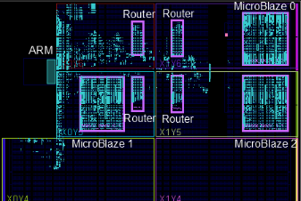
MPSoCSim
Comparison with HW implementation
Matrices multiplications: ARM generates the matrices, splits the computation, sends data to µBs and collects the results
Xilinx ZedBoard , 667 MHz (ARM), 100MHz (FPGA)
2x2 NoC
b00 | b01 | b02 | b03
b10 | b11 | a12 | b13
b20 | b21 | b22 | b23
b30 | b31 | b32 | b33
a00 | a01 | a02 | a03
a10 | a11 | a12 | a13
a20 | a21 | a22 | a23
a30 | a31 | a32 | a33
c00 | c01 | c02 | c03
c10 | c11 | c12 | c13
c20 | c21 | c22 | c23
c30 | c31 | c32 | c33
ARM
µB1
µB2
µB3
[1] “P. Wehner, et al., “MPSoCSim: An extended OVP Simulator for Modeling and Evaluation of NoC based heterogeneous MPSoCs”, in proc. of ViPES in SAMOS, 2015.
Notes:
32 bits flit size
Xilinx ZedBoard or Xilinx Zynq SoC
ARM <-> NoC HP port
FSL

Slide 10
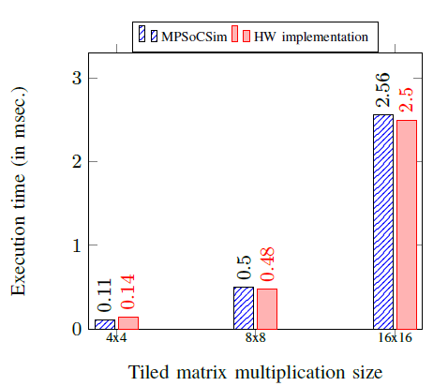
MPSoCSim
Comparison with HW implementation
Deviation (sim. exec. time / exec. time on HW)
from 17% down to 2,5%
[1] “P. Wehner, et al., “MPSoCSim: An extended OVP Simulator for Modeling and Evaluation of NoC based heterogeneous MPSoCs”, in proc. of ViPES in SAMOS, 2015.

Slide 11
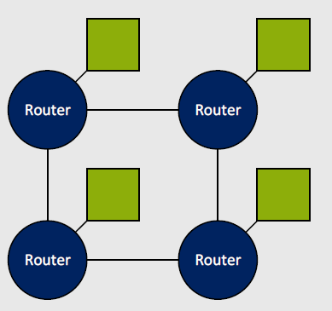
MPSoCSim extension
Cluster
Cluster
Cluster
Cluster

Slide 12
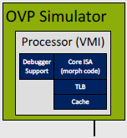
MPSoCSim extension
Local memory for code, heap and stack
Adjustable/heterogeneous number of subgroups and processors
Subgroup
Shared memory for communication
Local RAM
Local RAM
Shared
RAM
Local bus
Shared bus
Local RAM
Local RAM
A cluster

Slide 13
Evaluation
Experimental protocol
Regular clusters composed of 4 µBs, one cluster composed of 1 ARM
2x2 (12 µBs + 1 ARM) and 4x4 (60 µBs + 1 ARM) clusters architecture
Evaluation through matrices multiplications
Evaluation of the scalability of simulated systems
Debugging, detection of bottleneck…
Simulation of homogeneous/heterogeneous systems
Notes:
The results presented in this paper
have been generated on an Intel Core 2 Quad Q9400, 2.66GHz
frequency PC with 3.87 GB RAM (usable).

Slide 14
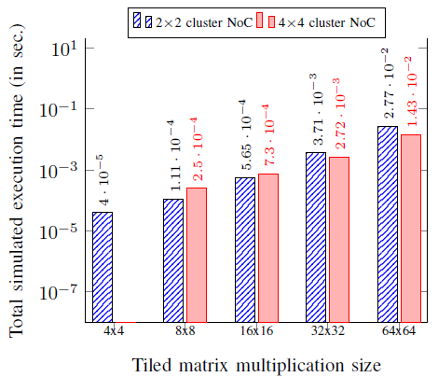
Evaluation
Simulated execution time
Trade-off between computing resources and communication costs
- Scalabilité en termes de temps de simulation
Aussi on peut voir ici le moment à partir duquel ça vaut le coup de passer à une architecture plus large (lorsque le cout comm est amorti)

Slide 15
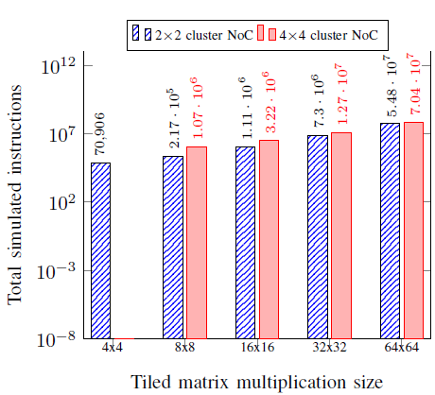
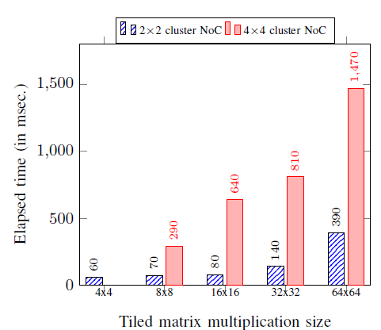
Evaluation
Simulated execution time + scalability
Very fast simulations on the host machine for a large number of simulated instructions
N.B. Results generated on an Intel Core 2 Quad Q9400, 2.66GHz frequency PC with 3.87 GB RAM (usable)

Slide 16
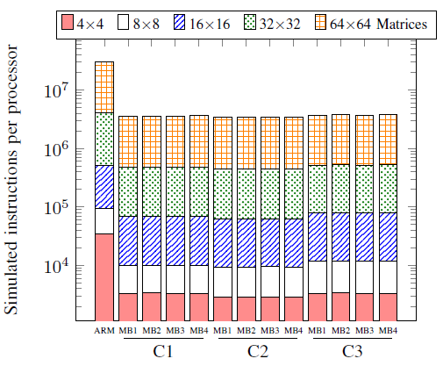
Evaluation
Validation of execution scenarios
Communication problem detection, validation of the execution scenario
The µBs perform the same number of instructions, only the communication distance varies between clusters
Also, NI statistics are useful for validation of execution scenarios

Slide 17
Use case
Dynamic scenario
A specific processor behaves as a controller of the platform executing strategies of dynamic deployment of applications:
Scheduling, monitoring, mapping, resources allocation
PE
PE
L1
L1
L1
L1
L2
R
R
R
PE
PE
Applications
R
R
R
Ctr
R
R
R
Many-core architecture
[2] “M. Méndez Real, et al., “Dynamic Spatially Isolated Secure Zones for NoC-based Many-core Accelerators”, in proc. of ReCoSoC, 2016.

Slide 18
Conclusion
MPSoCSim extension for evaluation of clustered NoC-based systems
Clusters composed of an adjustable number of subgroups, that can be heterogeneous between different clusters
Processor models within clusters may be heterogeneous
Local memory for code, heap and stack
Shared memory within clusters, distributed between clusters for communication
Processors may execute independent concurrent applications
Future work
Comparison of a large system with the HW implementation
Evaluation on further applications/benchmarks

Slide 19
Thank you for your attention
Questions?

Slide 20
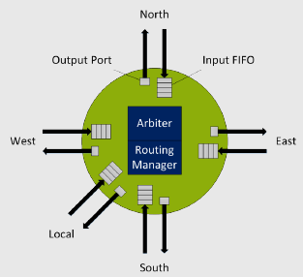
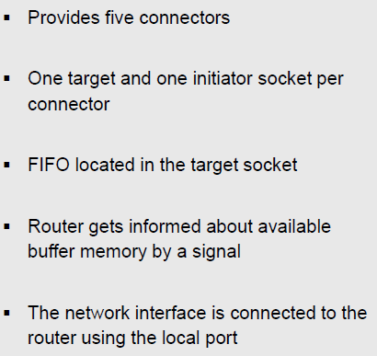
Router

Slide 21
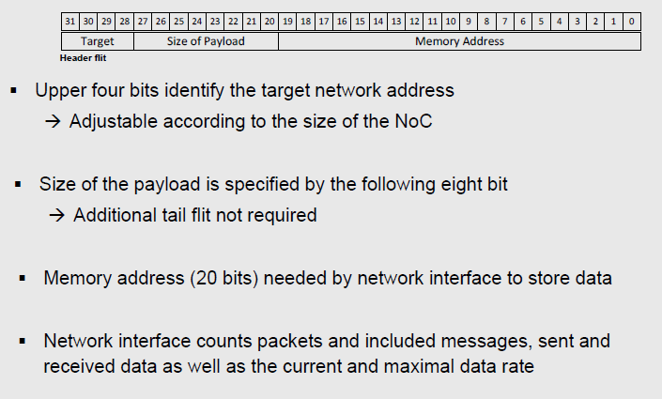
Flits

Slide 22
Related work
Overview of simulation platforms for NoC-based MPSoCs [1]
Simulator | Modelling language | Communication infrastructure | Topology | Parameterizable | Processing elements | Simulation Results
Nirgam | SystemC | NoC | Mesh, Torus, Butterfly, etc. | Yes | Traffic Generators | Performance, power
Noxim | SystemC | NoC | Mesh | Yes | Traffic Generators | Performance, power
Booksim | C++ | NoC | Mesh, Torus, Butterfly, etc. | Yes | Traffic Generators | Performance
HNoCs | C++ | NoC | Mesh | Yes | Traffic Generators | Performance, power
Rosa et al. | SystemC | Bus | - | - | Traffic Generators | Performance, power
…
MpSoCSim | SystemC | NoC | Mesh | Yes | Traffic Generators + OVP processor models | Performance
A large number of NoC-based MPSoCs
Each suitable for a specific type of exploration problems
We searched for complex clustered NoC-based multi/many-core systems supporting processor models
[1] “P. Wehner, et al., “MPSoCSim: An extended OVP Simulator for Modeling and Evaluation of NoC based heterogeneous MPSoCs”, in proc. of ViPES in SAMOS, 2015.

Slide 23
MPSoCSim
Exploitation results
OVP processor
NoC parameters
NI statistics
Simulation
OVP results
User time: Time spent for the execution on the host machine
System time: Spent by the host machine to execute instr. of the simulation process
Elapsed time: Simulation time from beginning to end
Simulated time: Duration of the simulation process in simulated time
Number of simulated instructions
Notes:
User time: Time spent for the execution on the host machine
System time: Spent by the host machine to execute instr. of the simulation process
Elapsed time: Simulation time from beginning to end
Simulated time: Duration of the simulation process in simulated time
TLM abstraction level modeling abstraction model above RTL accelerating simulation everothi,g is event (function call)
TLM is the glue between diff API /models from diff sources (wrapper)
Losely time = run as fasst as possible simulation, only the minimum time information

